Slide 1
Chapter 9 : System test design
DINH THI MY CANH

Slide 2
Contents
Requirement Identification
Test Objective Identification
Modeling A Test Design Process
Modeling Test Results
Test Design Preparedness Metrics
Test Case Design Effectiveness
Summary

Slide 3
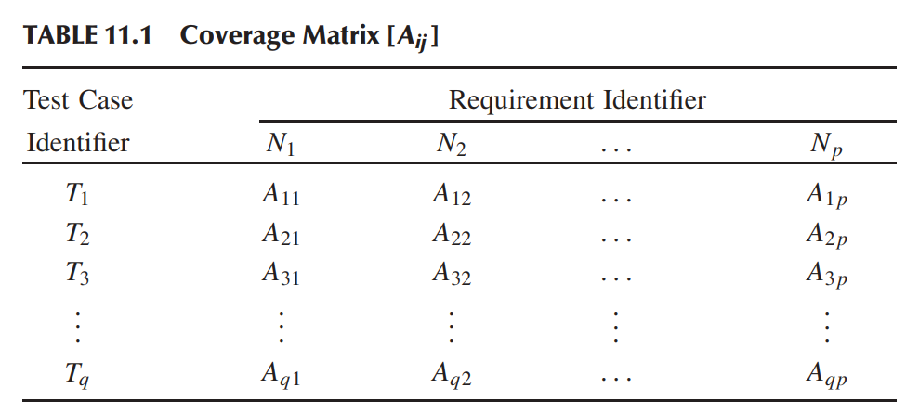
coverage matrix

Slide 4
1. Requirement Identification
Determine the requirement description is testable:
Take the following requirement description: The system must perform X
Then encapsulate the requirement description to create a test objective: Verify that the system performs X correctly.
Review this test objective by asking the question: Is it workable?
If is yes, then the requirement description is clear and detailed for testing purpose. Otherwise, more work needs to be done to revise or supplement the requirement description

Slide 5
1. Requirement Identification
In addition to the testability of the requirements, the following items must be analyzed by the system test engineers during the review
Safety
Security
Completeness
Correctness
Consistency
Clarity
Relevance
Feasibility
Verifiable
Traceable

Slide 6
2. Test Objective Identification
The question “What do I test?” must be answered with another question: “What do I expect the system to do?”

Slide 7

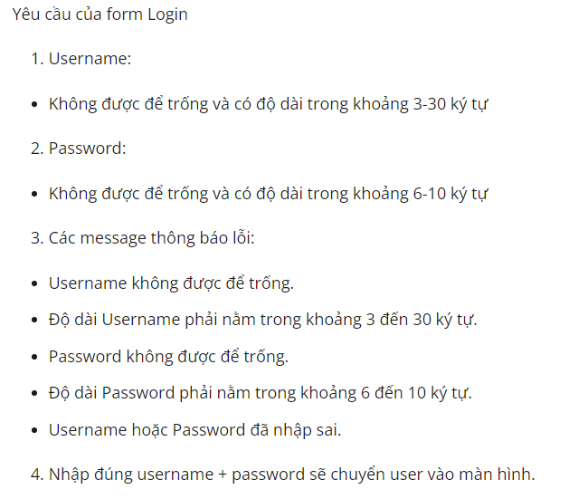
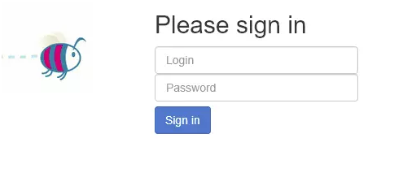
Example: Login form

Slide 8
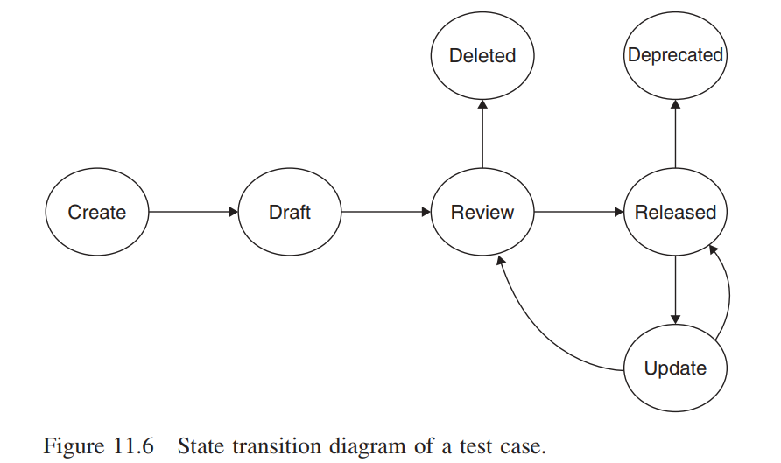
3. Modeling A Test Design Process

Slide 9
3. Modeling A Test Design Process
The state transition model shows the different phases, or states, in the life cycle of a test case from its inception to its completion through the following states: create, draft, review, deleted, released, update, and deprecated.
Create State A test case is put in this initial state by its creator, called the owner or creator, who initiates the design of the test case.
Draft State The owner of this state is the test group, that is, the system test team

Slide 10
3. Modeling A Test Design Process
Review and Deleted States The owner of the review state is the creator of the test case.
Released and Update States A test case in the released state is ready for execution, and it becomes a part of a test suite.
Deprecated State An obsolete test case may be moved to a deprecated state.

Slide 11
4. Modeling Test Results
A test suite schema can be used by a test manager to design a test suite after a test factory is created.
We model the results of test execution by using a state transition diagram as shown in Figure 11.7
The corresponding schema is given in Table 11.8.

Slide 12
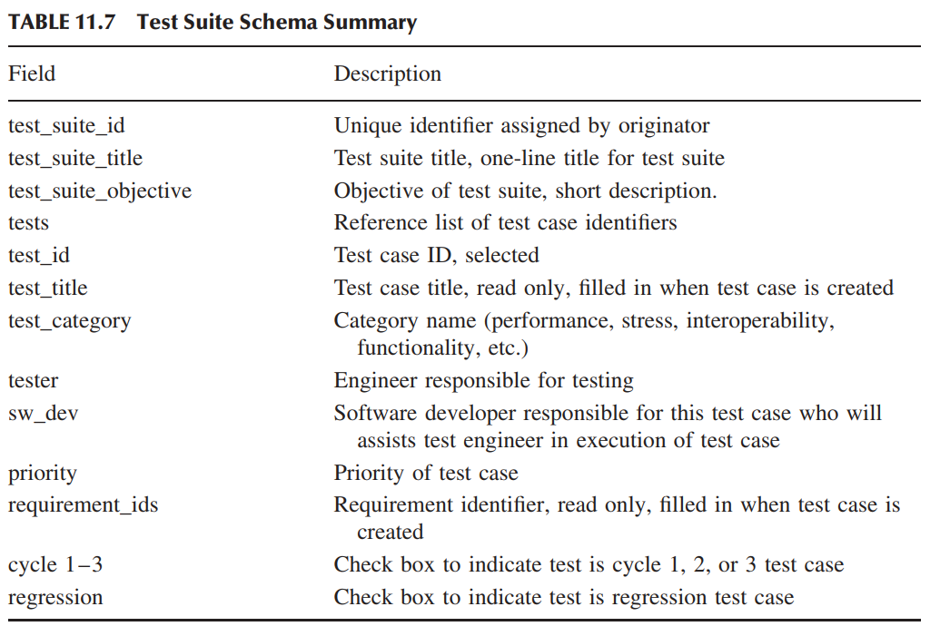

Slide 13
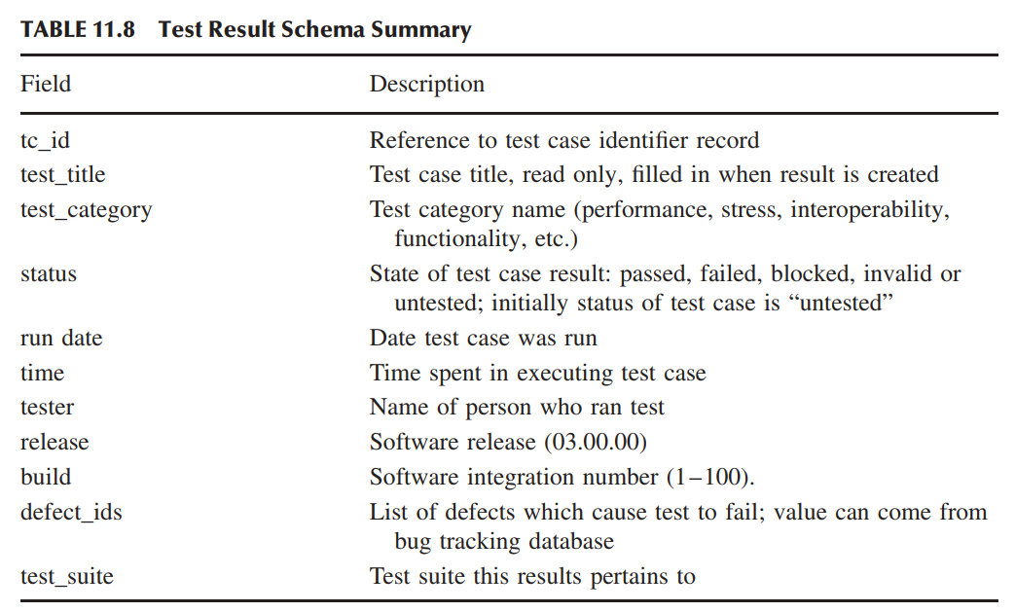

Slide 14
5. Test Design Preparedness Metrics
Preparation Status of Test Cases (PST): A test case can go through a number of phases, or states, such as draft and review, before it is released as a valid and useful test case.
Average Time Spent (ATS) in Test Case Design
Number of Available Test (NAT) Cases
Number of Planned Test (NPT) Cases
Coverage of a Test Suite (CTS)

Slide 15
6. Test Case Design Effectiveness
The objectives of the test case design effectiveness metric is:
To measure the “defect revealing ability” of the test suite
Use the metric to improve the test design process

Slide 16

6. Test Case Design Effectiveness
A metric commonly used in the industry to measure test case design effectiveness is the test case design yield (TCDY), defined as :
Number of Planned Test (NPT) Cases
New test cases are designed (TCE)

Slide 17
7. Summary
We presented a requirement schema that can be used to generate a traceability matrix. A traceability matrix finds two applications:
Identifying and tracking the functional coverage of a test suite
Identifying which test cases must be exercised or updated when a system undergoes a change.
A traceability matrix allows one to find a mapping between requirements and test cases as follows:
From a requirement to a functional specification to specific tests which exercise them
From each test case back to the requirements and functional specifications

Slide 18
THE END

